Slide 1

DAR – DEFENCE ADVANCE ROVER
PRESENTED BY: Batch 6
Kaushik Wagh R- 19BTRIS047
Sagar Katekhaye- 19BTRIS034
Holachi Vaishnavi- 19BTRIS059
Ayush Kumar- 19BTRIS048
Aman Kalavadia- 19BTRIS019
GUIDED BY:
Dr. Jayanthi Kannan
Professor & HOD
Department of ISE
Faculty of Engineering & Technology

Slide 2
Abstract
A Rover is a IOT based robot that is basically designed to detect Landmines, Smoke, Fire, Alignment, Obstacles, Radar to detect Movement. In this research we prepare a Rover as a prototype of multi-functional robot and the purpose of it is to go to dangerous areas like collapsed places, areas attacked by terrorists to collect every possible data of the situation and send it via wireless communication system (Remotely), as well as manually for the further actions. The main phenomenon of this Rover is to help army by providing various information which usually is difficult and risky for a person to collect and send it to the control center. The whole system operates wirelessly and send each and every data to the control center through signals, and shows live video footage directly to the control center, even if the camera is damage the remaining sensors keeps providing the data.

Slide 4
INTRODUCTION
Machine learning has come a long way in the last few years. State of the art results in computer vision, speech recognition, language processing and many other areas are delivered by machine learning algorithms.
A spike in the interest in subfields like Deep learning and Artificial Neural Networks is heavily influenced by computation costs coming down greatly so that research can be carried out much more feasible than before.
Even though there are hundreds of architectures in the deep learning literature, and many more get invented every single day, two of them have revolutionized the space like none before - CNNs (Convolutional Neural Networks) and RNNs (Recurrent Neural Networks).

Slide 5
LITERATURE SURVEY
Title of Paper - Long short-term memory (Published in Neural Computation 9 1997)
Authors - S. Hochreiter and J. Schmidhuber
Methodology - The authors came up with a new cell for Recurrent Neural Networks called LSTM cells. The LSTM cell consists of three gates - Forget gate, Input gate, Output gate. These combined give the LSTM network its stability.
Advantages - They tackled the problem of vanishing and exploding gradients that had persisted in RNNs for long. Now longer sequences can be learned from.

Slide 6
LITERATURE SURVEY
Title of Paper - GRUV: Algorithmic Music Generation using Recurrent Neural Networks, 2015, Stanford
Authors - Aran Nayebi, Matt Vitelli
Methodology - Using raw mono-channel audio sampled at 44.1kHz that has been transformed to frequency domain as the internal model representation. Music generation is a sequence modelling task, and since in this case the input is continuous, it becomes a regression task. A single LSTM unit network and a single GRU unit network were used.
Pros - It becomes evident that music generation is possible using minimally pre-processed audio data and quite simple network architectures.
Cons - Data used for training was limited in scope, very simplistic network architectures used for the task.

Slide 7
LITERATURE SURVEY
Title of Paper - Music Generation Using Deep Learning (Published in ArXiv 2016)
Authors - Vasanth Kalingeri, Srikanth Grandhe
Methodology - Using raw mono-channel audio sampled at 16KHz and transformed using Fourier Transform. Devising new and novel model architectures for better solutions to the sequence modelling task at hand. Uses Convolutions and Dense layers for creating new architectures and performing a comparative analysis.
Pros - Improved performance using new architectures as compared to the baseline LSTM model.
Cons - Testing of newer models proved difficult and therefore reasons for their better performance are not known concretely.

Slide 8
LITERATURE SURVEY
Title of Paper - LSTM Based Music Generation System (Published in ArXiv 2019)
Authors - Sanidhya Mangal, Rahul Modak, Poorva Joshi
Methodology - Using midi files for creating a ‘Note Matrix’, 3D tensor with note, note velocity and time interval forming the dimensions of the matrix. This matrix is the input for a simple LSTM network, which uses dropout for regularisation.
Pros - Model can generate polyphonic music with melodies and harmonies.
Cons - Simple architecture that can be further explored, midi files have much less data as compared to raw audio files.

Slide 9
LIMITATION OF CURRENT WORK
Computer generated music usually does not have structure - a beginning, middle and end. Incorporation of note offsets has also not been explored enough in the field.
Provide a comparative analysis of different architectures and explore architectures of different types and understand their varying performance on the task of generating music that sounds good to the human ear.
Incorporate human interaction in the process of generating music so that composers and musicians can benefit from the proposed work.

Slide 10
OBJECTIVES
Explore LSTM networks for the task of music generation and achieve good results on our task.
Explore different architectures with respect to the quality of music generated and perform a comparative analysis.
Generate melodies that sound good to the human ear and try to incorporate user interaction in the generation process.

Slide 11
Produce Computer generated music that is similar in nature to Human composed music
PROBLEM STATEMENT

Slide 12
METHODOLOGY
Input Layer
Data collection and preprocessing
Constructing network
Preparing sequences
Training
Evaluation
Hyper parameter tuning
App Deployment
LSTM Layer
LSTM Layer
LSTM Layer
Batch Normalization
x2
Dropout
Dense Layer
Softmax
Fig. Baseline Model

Slide 13
METHODOLOGY
Music21, a library that is capable of understanding notes and other components that make a musical piece.
Different hyperparameters that will be used during training like learning rate, optimizer, weight decay, etc
The generation of music will be carried out using the same network that learns from our input music corpus. introducing user interaction for the generation process. The user can be allowed to give inputs in the form of a starting note for the piece, or the key that the piece should be constructed in.

Slide 14
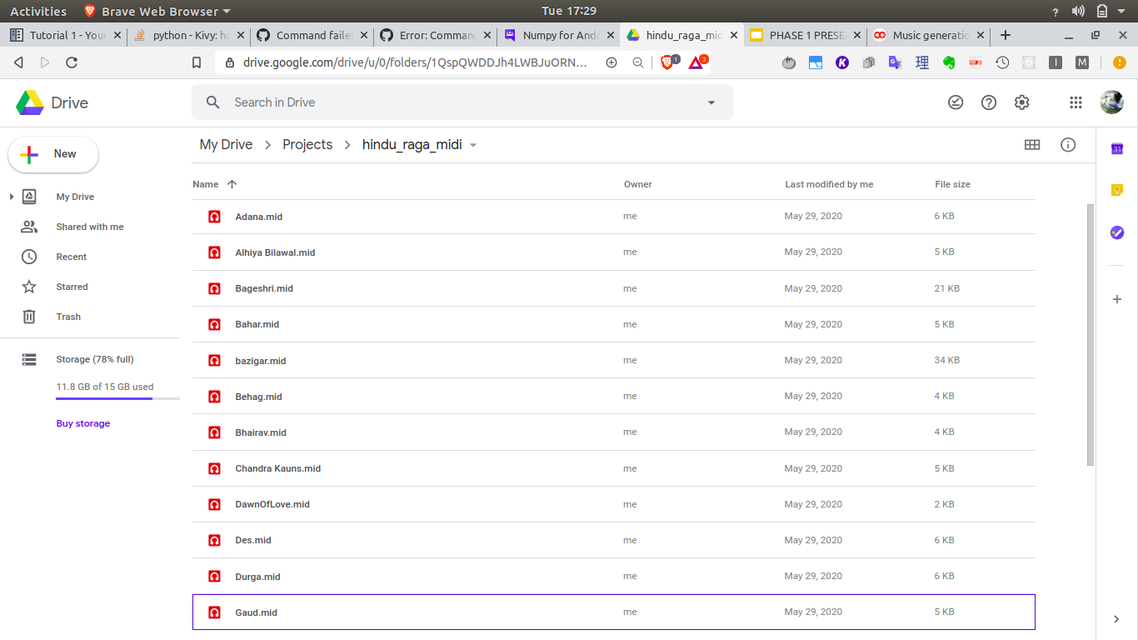
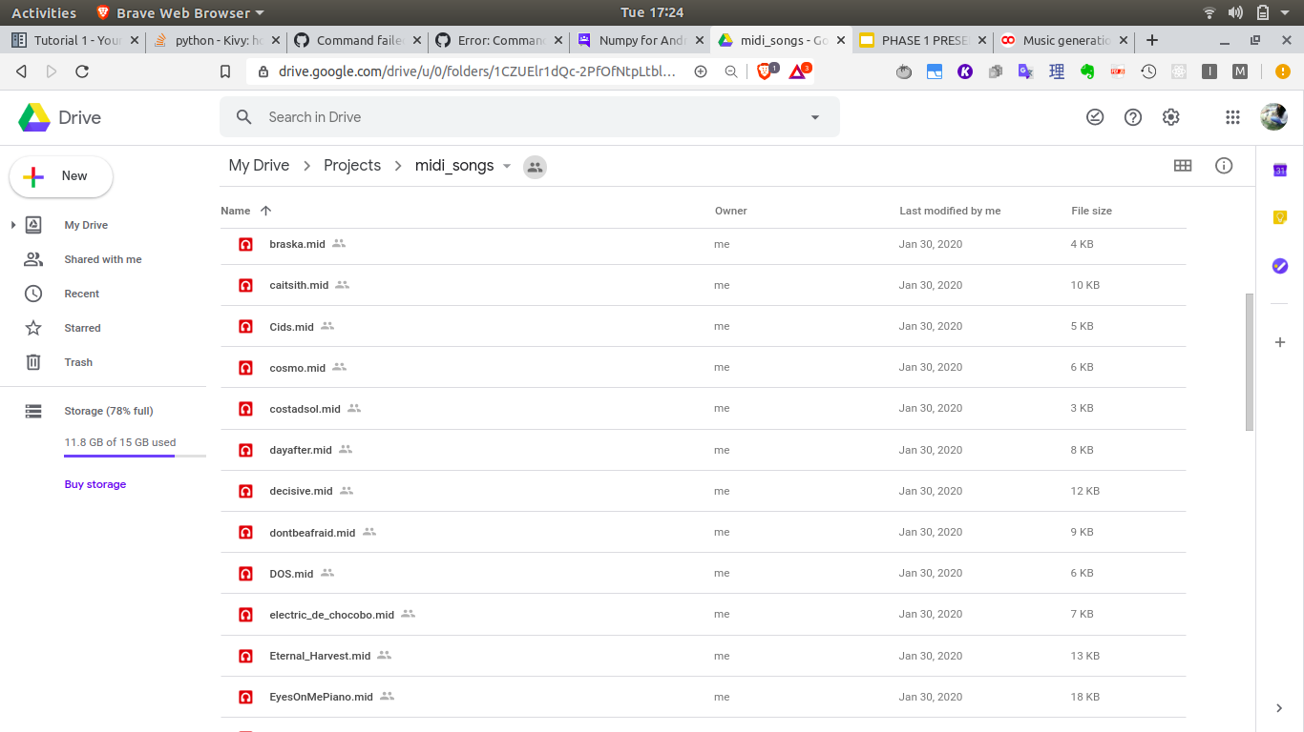
IMPLEMENTATION
Midi files were downloaded from the internet in two categories - Classical piano and Classical Indian
We collected 82 classical piano files and 28 classical indian raga files

Slide 15
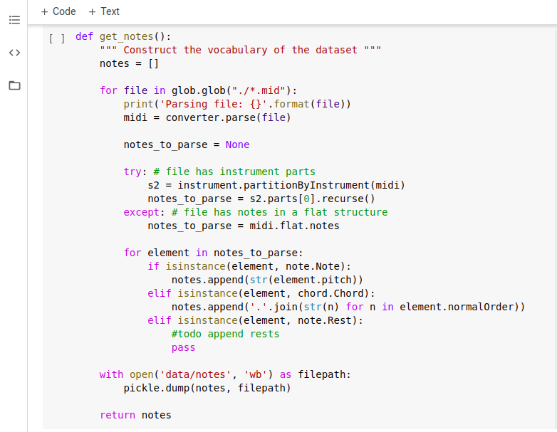
IMPLEMENTATION
The midi files are processed and a vocabulary of their notes is constructed

Slide 16
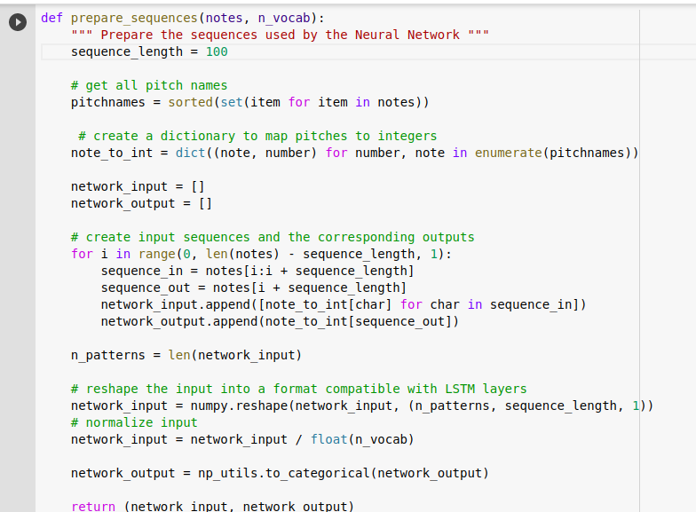
IMPLEMENTATION
Preparing sequences to be fed into the network for training
Sequence length is fixed at 100
Notes are converted from string to integer representation

Slide 17
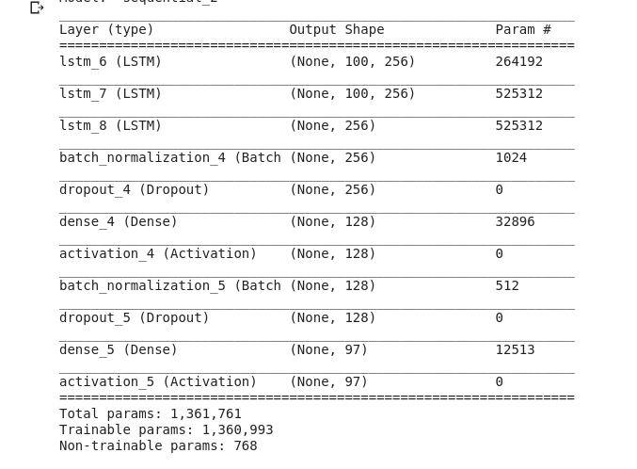
IMPLEMENTATION
Constructing the network architecture to predict the next note in a sequence using Softmax activation function
We use categorical cross entropy as the loss function and RMSProp as the optimizer

Slide 18
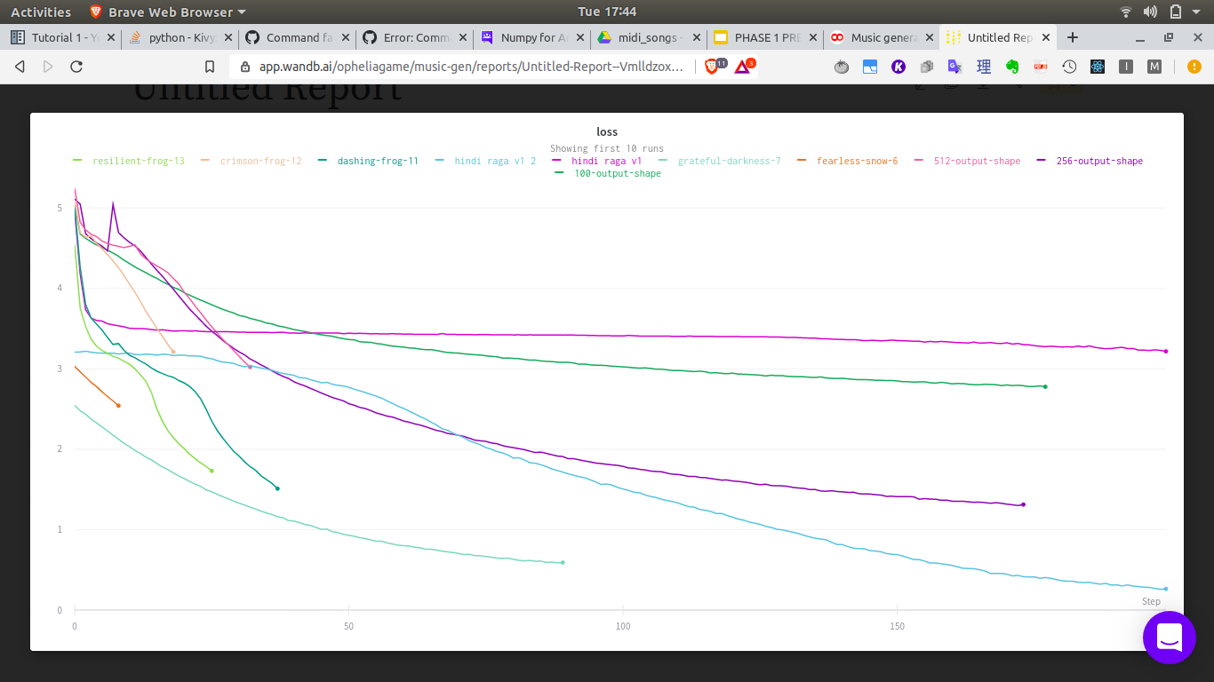
RESULTS

Slide 19
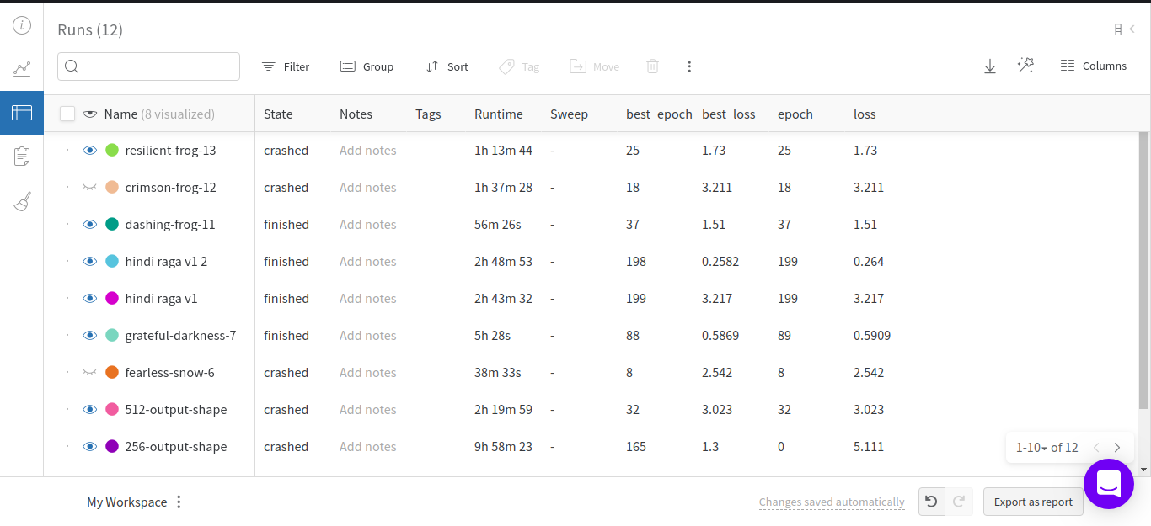
RESULTS

Slide 20

RESULTS
The Homecoming Queen's Got A Knight
Rhythm of the Flower
Whole Lotta Poppies

Slide 21
Project modules description

Slide 22
Project modules Explanation

Slide 23
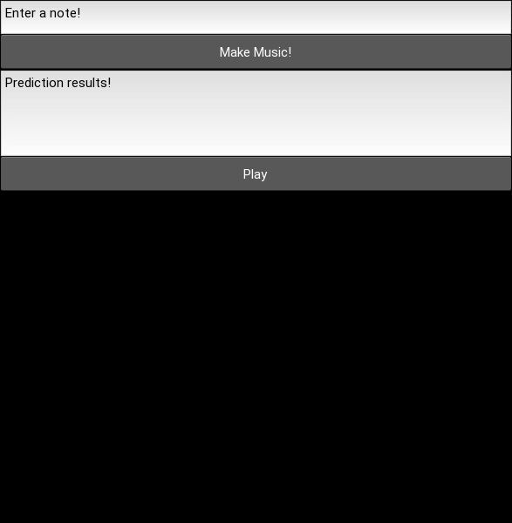
RESULTS

Slide 24
Conclusion
This project aims to show that music generation using machine learning methods is a promising application. We have been able to generate music that has a good structure, and resembles human composed music in the sense that it displays many of the same qualities that human composed music does. It has a temporal and melodic structure that is pleasing to the ear, and resembles the dataset that the network has been trained on. On the same hand, there are many possibilities that can further be explored.

Slide 25
PROJECT TIMELINE
Activities | Time in Months | Expected Challenges
Literature survey | 1 | Collecting papers from journals with paid subscription
Requirement collection and analysis | 1 | Collection of midi music data and analysis of different architectures
Design | 1 | Finalising the most suitable architecture to be used to train models.
Implementation | 1 | Staying connected to google collab while training for longer duration (12 hours)
Testing | 1 | Comparative analysis of different model architecture to achieve maximum accuracy and least loss

Slide 26
PROJECT COST ESTIMATION
Sl. No. | Particulars | Quantity | Cost in Rs.
1 | Google Colab Pro - T4 GPU | 1 | ₹ 0
2 | Flutter App Development | 1 | ₹ 0
3 | W&B platform | 1 | ₹ 0
Totall |  |  | ₹ 0

Slide 27
Sample code

Slide 28
Project Demo Screen shots pictures

Slide 29
Project Demo Video link Running / Execution/ working model Screen shots pictures

Slide 30
Project Demo working model Screen shots pictures

Slide 31
REFERENCES
Hawthorne, Curtis et al. “Enabling Factorized Piano Music Modeling and Generation with the MAESTRO Dataset.” ArXiv abs/1810.12247 (2019): n. pag.
Briot, Jean-Pierre et al. “Deep Learning Techniques for Music Generation - A Survey.” ArXiv abs/1709.01620 (2017): n. pag.
Dieleman, Sander et al. “The challenge of realistic music generation: modelling raw audio at scale.” NeurIPS (2018).
S. Hochreiter and J. Schmidhuber, "Long Short-Term Memory", Neural Computation, vol. 9, no. 8, pp. 1735-1780, 1997. Available: 10.1162/neco.1997.9.8.1735.
Kotecha, Nikhil and Paul Young. “Generating Music using an LSTM Network.” ArXiv abs/1804.07300 (2018): n. pag.
Bertin-Mahieux, "The million song dataset," International Society for Music Information Retrieval (ISMIR’11), vol. 2,no. 9, p. 10, 2011

Slide 32
Project POSTER PRESENTATION

Slide 33
Project patent IDF and Templates Description

Slide 34
JOURNAL PAPER PUBLICATION CERTIFICATE AND PUBLISHED PAPER

Slide 35
Thank you

